Slide 1
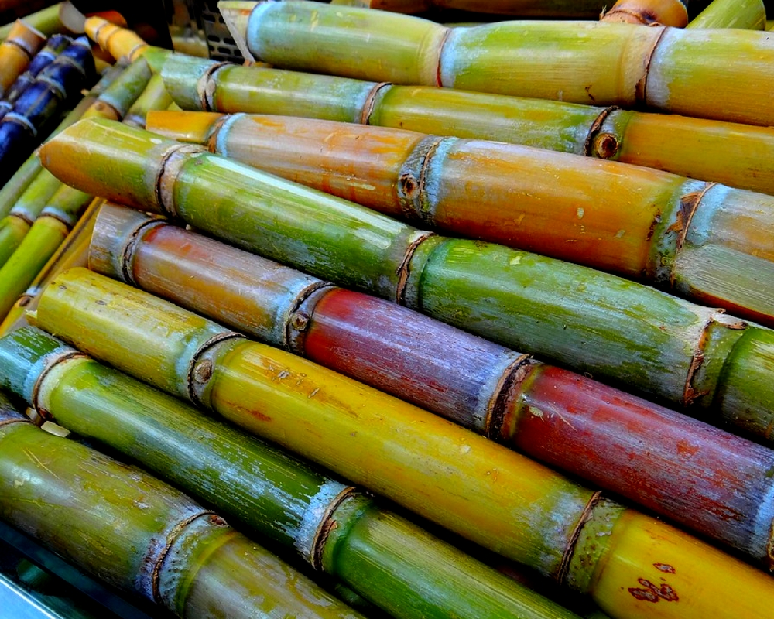
Sugarcane (Saccharum officinarum L.)
Abhinav Mishra
131503
8th Semester
Course Instructor : Dr. Anil Kant Thakur

Slide 2
Facts
Main source of sugar in India.
Prominent position as a cash crop.
Brazil Ranks first in Sugar Production (2015).

Slide 3
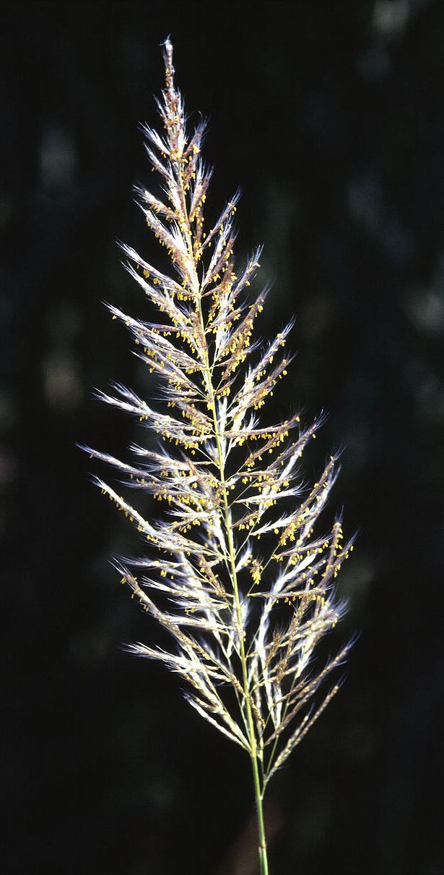
Origin
Cultivation => Vedic Period (1400 – 1000 BC)
‘Sugar’ is derived from Sanskrit word “Sakkara” or “Sarkara”
Thin Indian Cannes originated in the moist part of north eastern india (similar to Saccharum spontaneum)
Tropical cannes originated in the larger islands of oceania (New Guinea)
Notes:
New Guinea is located right side of Indonesia and above Australia.

Slide 4
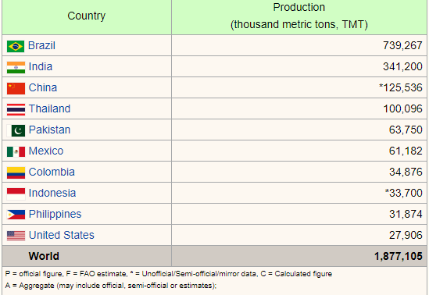
Area and Distribution
Source : Food And Agricultural Organization of United Nations: Economic And Social Department: The Statistical Division

Slide 5
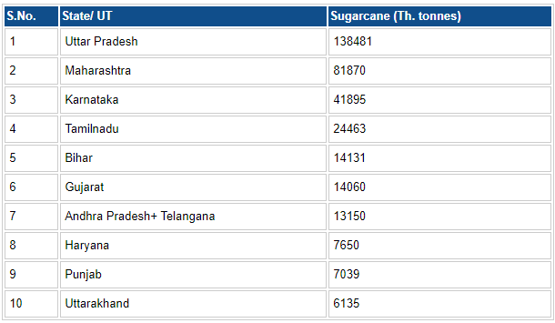
Source: Directorate of Economics and Statistics, Ministry of Agriculture

Slide 6
In India, Pricing Policy And Climatic Conditions play a major role in area and production.
Uttar Pradesh has the largest acreage :
48% of the area for the crop in whole India
38.6% of the total annual production

Slide 7
Classification

Slide 8
Notes:
http://theagricos.com/agriculture/crops/sugarcane/scientific-classification-sugarcane/

Slide 9
Climatic Requirements
Sugarcane is a tropical plant
It can grow in sub tropical regions also (North India)
Warm humid condition => Normal growth, unless terminated by flowering

Slide 10
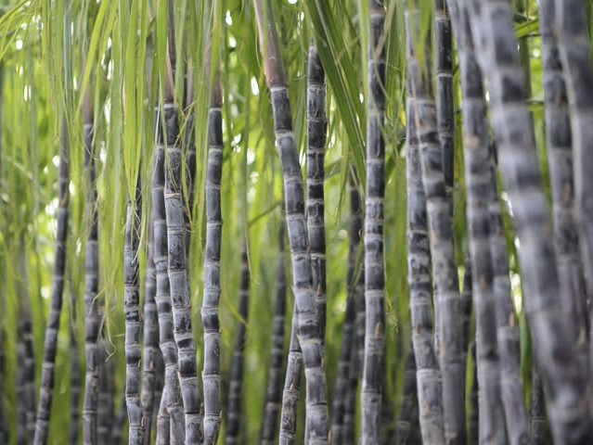
> 50ᵒ C => Growth halt
< 20ᵒ C => Slow growth*
*Low temperatures reduces tillering
Optimum Temperature : 26ᵒ C - 32ᵒ C
Optimum Rainfall : 75-180 cm/annum
Notes:
Tillering is the growth of new grass shoots

Slide 11
It requires a long growing season : 10 – 12 months, need certain number of heat units for plant to mature.
Ideal parts of the country are :
Telangana area of AP
Maharashtra
Parts of Karnataka

Slide 12
Under bright sunlight :
Stems are thicker but shorter
Leaves are broader and greener
Under low sunshine :
Stems are slender and long
Leaves are yellowish and narrower

Slide 13
Soil
It can be grown on all types of soil, ranging from sandy loam to clay loam.
It thrives best on well drained loamy soils.
Saline, alkaline and acidic, soils are not suitable for this crop
Northern India : Loams and clay loams (Alluviums)
Southern India : Brown/Reddish loams, laterites and black cotton soil
Notes:
Daylength influences :
Tillering
Flowering
Short day length decreases number of tillers per plant

Slide 14
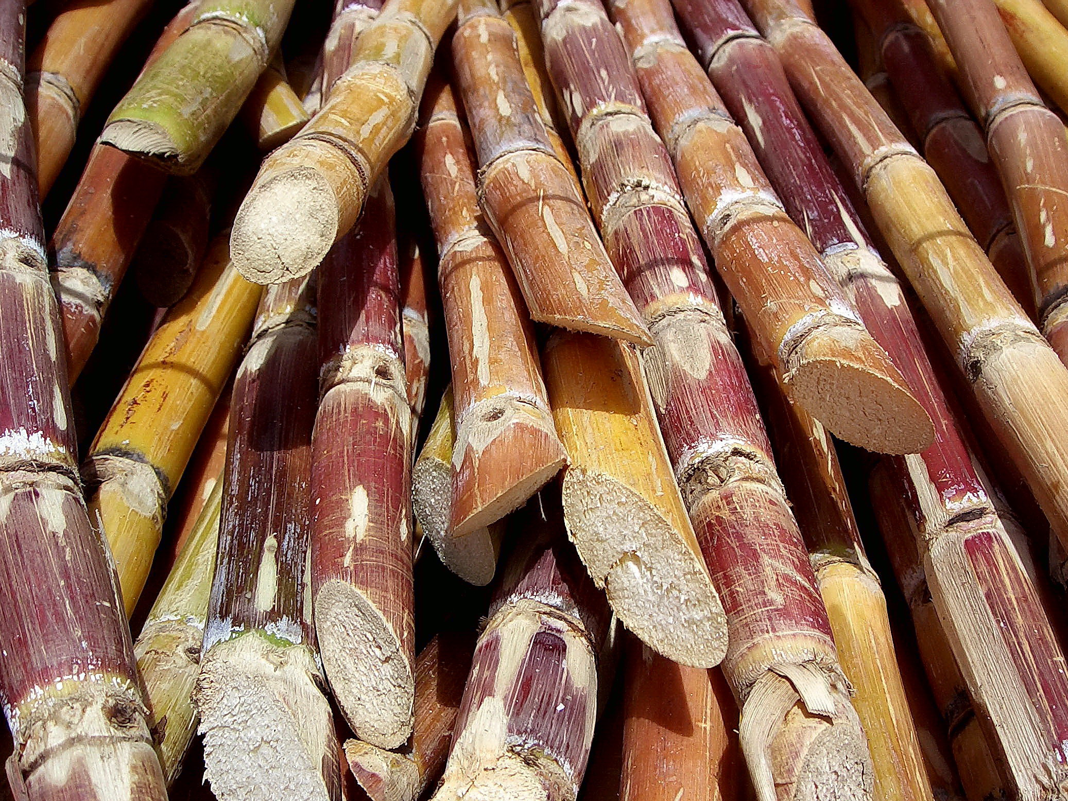
Varieties
Notes:
Sugar cane is being cultivated in our country over a wide range of contrasting agro-climatic conditions and the varietal requirements also vary from location to location.
To achieve this objective, ICAR initiated all india research project on sugarcane during 1970-71

Slide 15
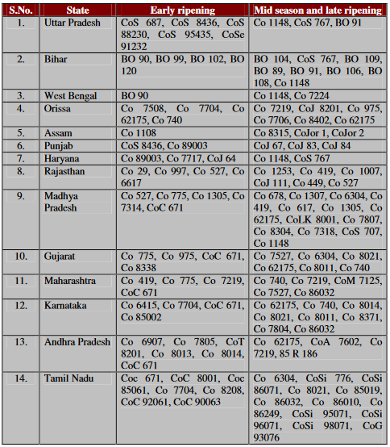
Source: Sugarcane Breeding Institute, Coimbatore (http://www.sugarcane-breeding.tn.nic.in/) &
Indian Institute of Sugarcane Research (http://www.iisr.nic.in/)

Slide 16
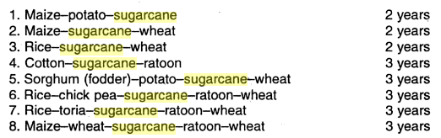
Cropping System
1. Northern India

Slide 17
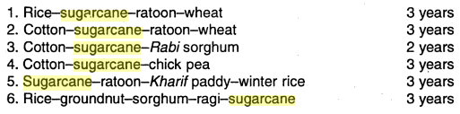
2. Southern India

Slide 18
Seed and Sowing
Seed Selection
Seeds must be free from pests and diseases like red rot, wilt, smut, ratoon stunting etc.
Top one third – half portion of cane has buds of high viability (Best for sowing)
Should be taken from well manured, erect and healthy crop (Age < 10-12 months)
Bottom portion of cane is rich in sugar and takes long time in germination (Jaggery Making)

Slide 19
2. Seed Preparation and Treatment
Dry leaves are removed by hands (avoiding damage)
Cane is cut into three budded sets 30- 45 cm long
35,000 – 40,000 seeds are needed to plant one hectare
To prevent the seed setts being attacked by fungal diseases and also to improve germination:
0.5% of Agallol (3%)
0.25% of Aretan (6%)
Aretan + Lindane (Northern India)
Notes:
Agallol is a mercurial fungicide

Slide 20
3. Time of Planting
3 times in a year (October, Feb- March and July)
Requires about 25-32ᵒ C for good germination
Delay causes reduction in yield due to low temperature
March -> Punjab and Haryana
Feb – March -> UP
Jan – Feb -> Bihar
Dec – Feb -> AP, TN, Maharashtra and Karnataka

Slide 21
Manures and Fertilizers
Fertilizer requirement depends upon :
Soil
Climate
Nitrogen : 120-150 kg/hectare
250-350 kg/hectare
Phosphorous : 80 kg/hectare of P₂O₅
100 kg/hectare of P₂O₅
Potash : 60 kg/hectare of K₂O
80 kg/hectare of K₂O
Notes:
Bold are for northern india

Slide 22
Water Management
Life cycle of the crop (phases) :
Germination (0 – 60th day)
Formative (60th – 130th day)
Grand (130th – 150th day)
Maturity (250th – 265th day)
Total Water Requirement : 200-300 cm

Slide 23
Northern:
Avg. 7 irrigations, 5 before and 2 after monsoon
Southern:
8-10 irrigations
Note: In each irrigation, 3 acre inch of water should be applied
Drainage helps in increasing the yield of cane as well as increasing the sucrose content of the cane.

Slide 24
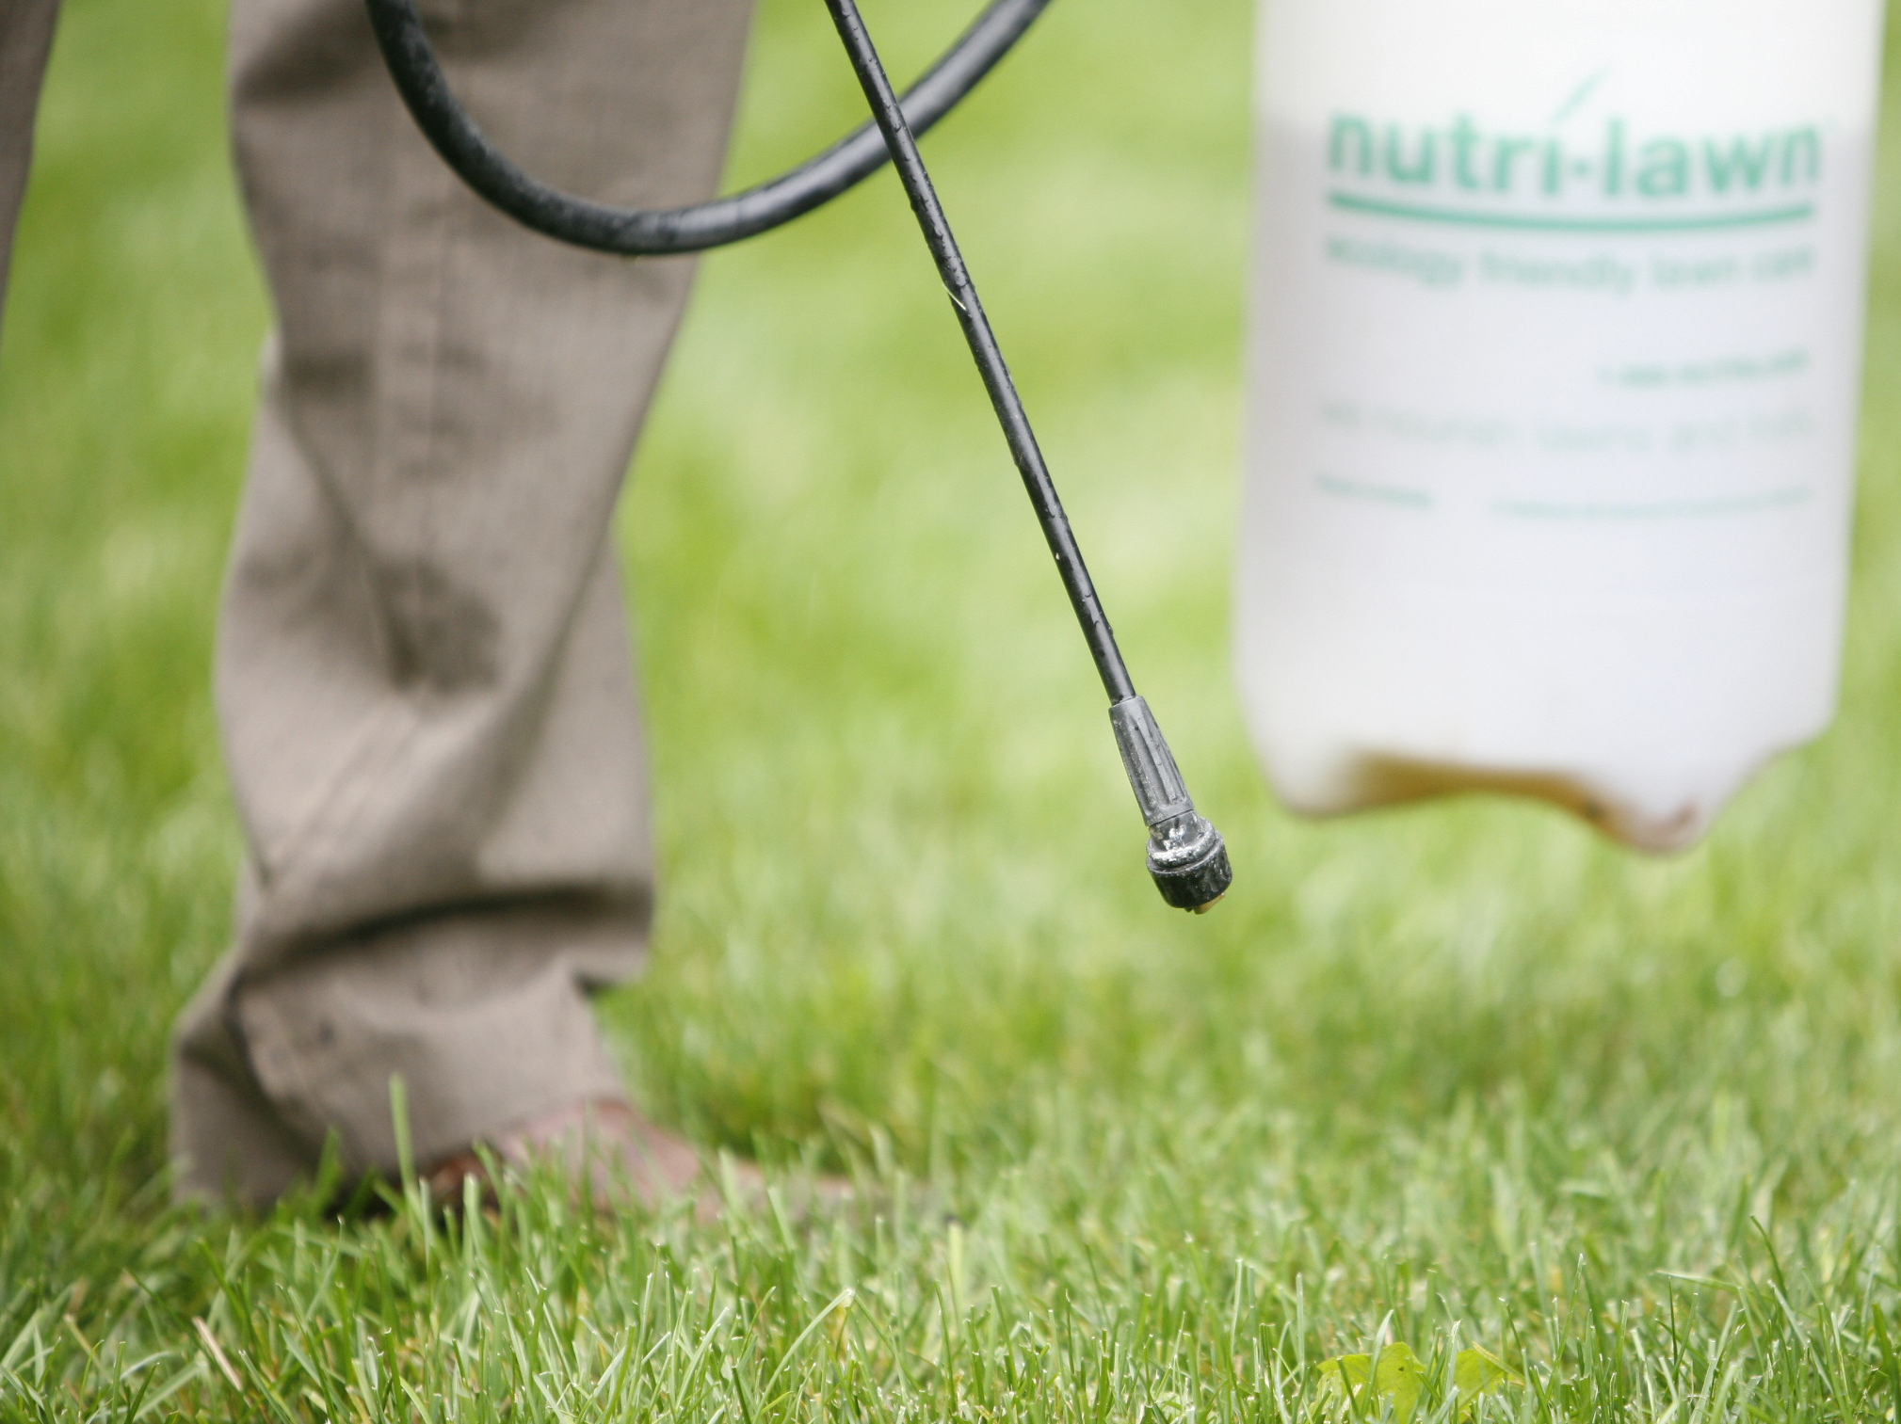
Weed Control

Slide 25
Autumn Sugarcane

Slide 26
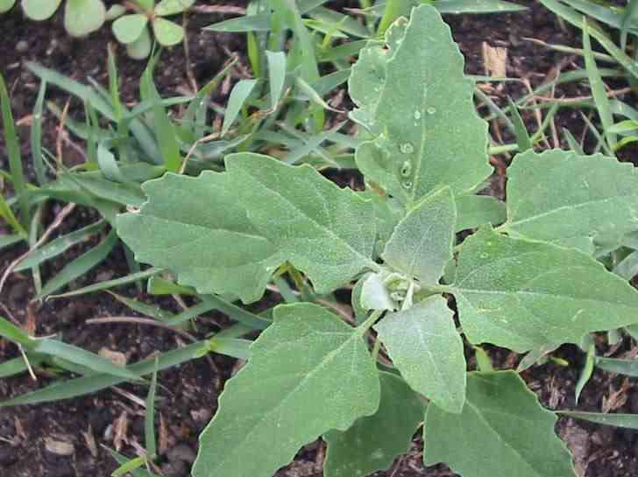
Chenopodium album a.k.a. Bathua

Slide 27
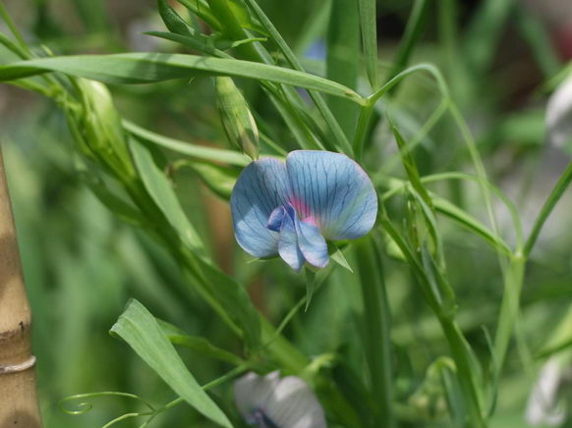
Lathyrus sativa a.k.a. Matri

Slide 28
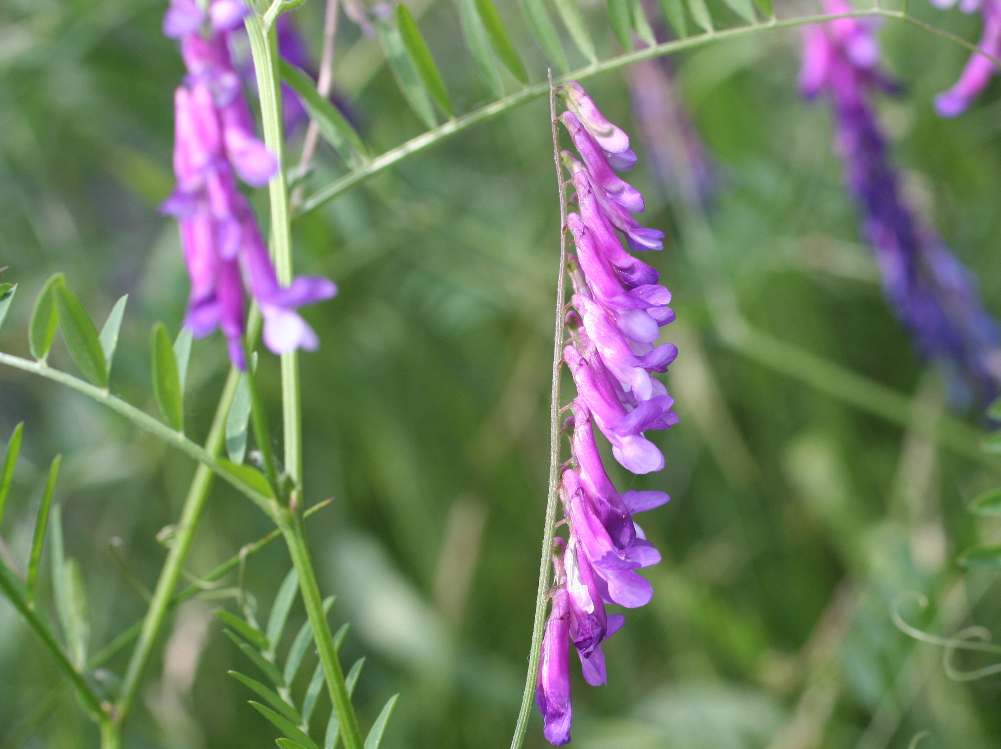
Vicia spp. a.k.a. Ankari

Slide 29
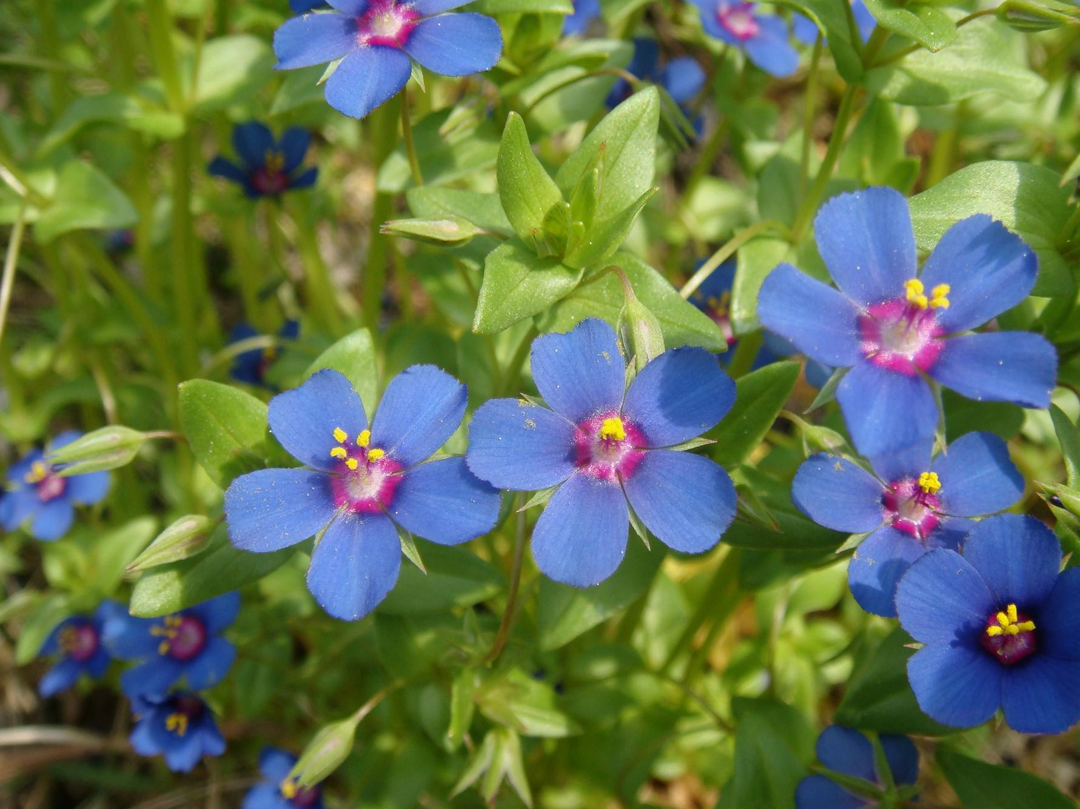
Angallis arvensis a.k.a. Krishna neel

Slide 30
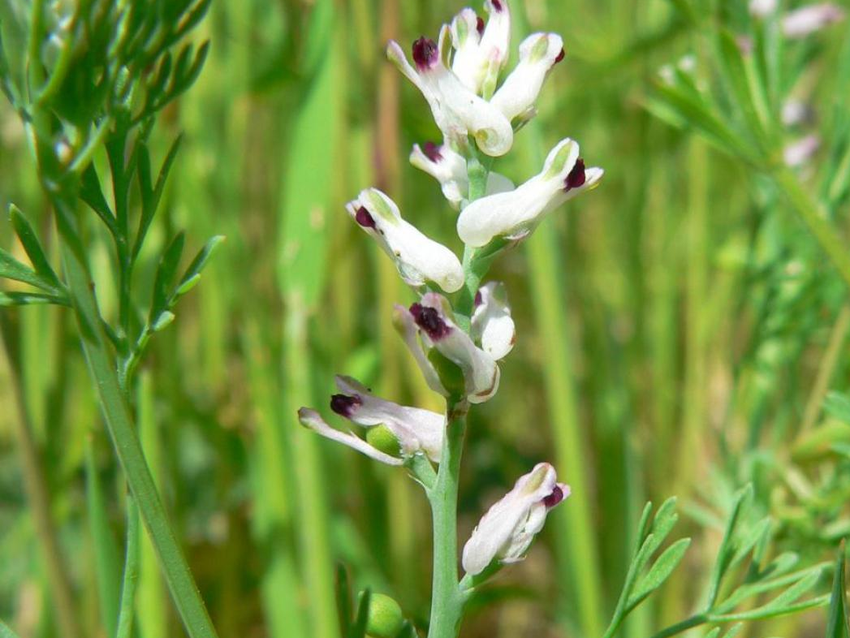
Fumaria parviflora a.k.a. Gajri or Soya

Slide 31
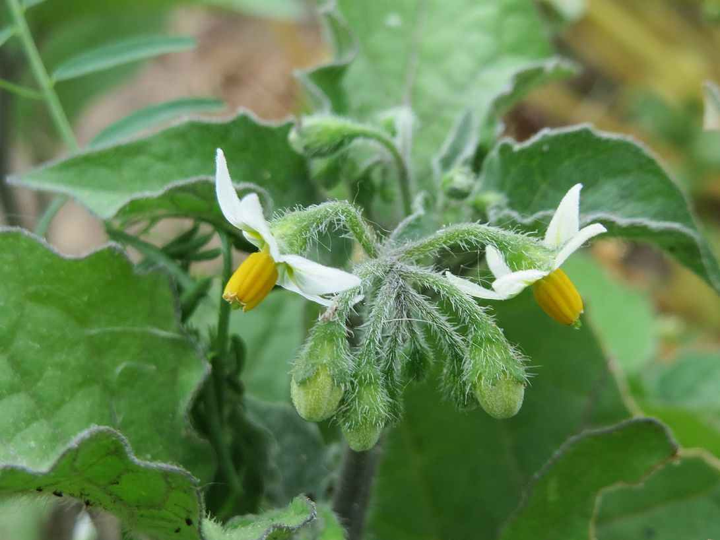
Solanum nigrum a.k.a. Makoya

Slide 32
Spring Sugarcane

Slide 33
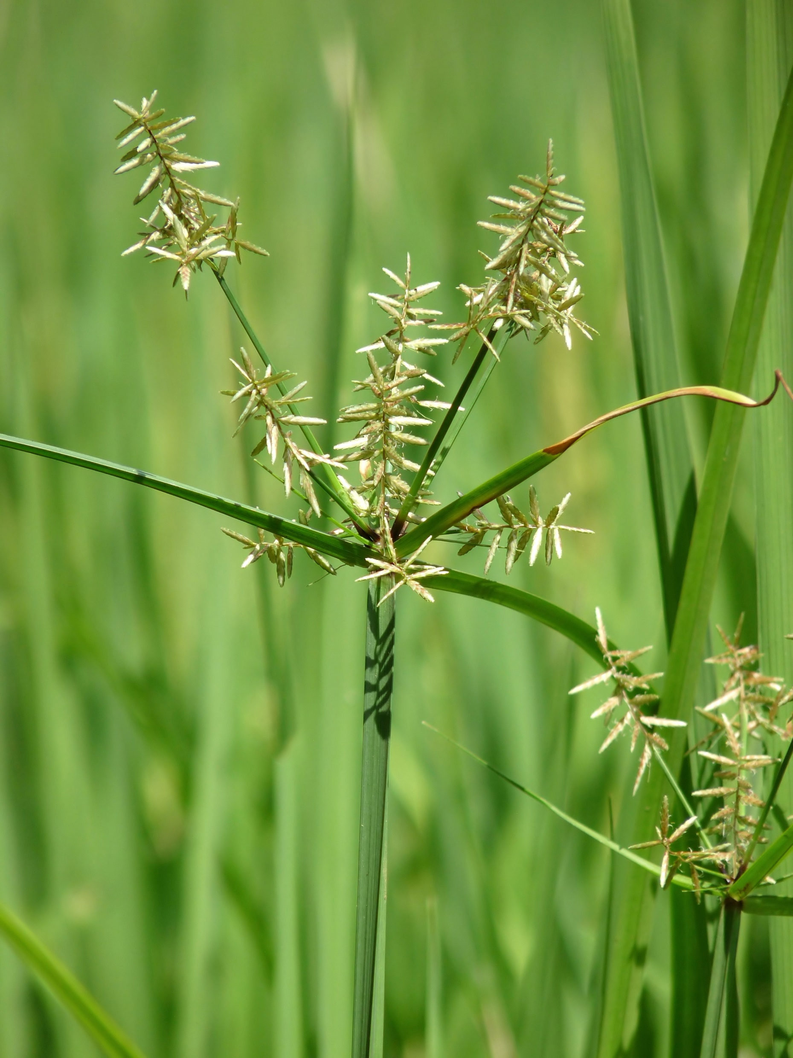
Cyperus rutundus a.k.a. Motha

Slide 34
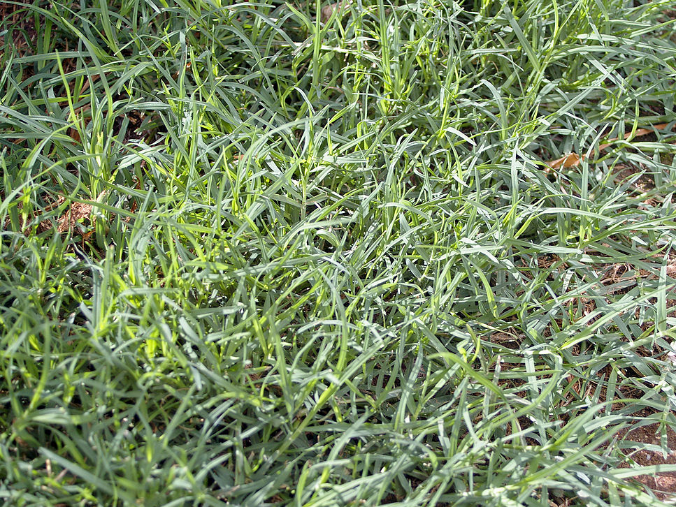
Cynodan dactylon a.k.a. Doob

Slide 35
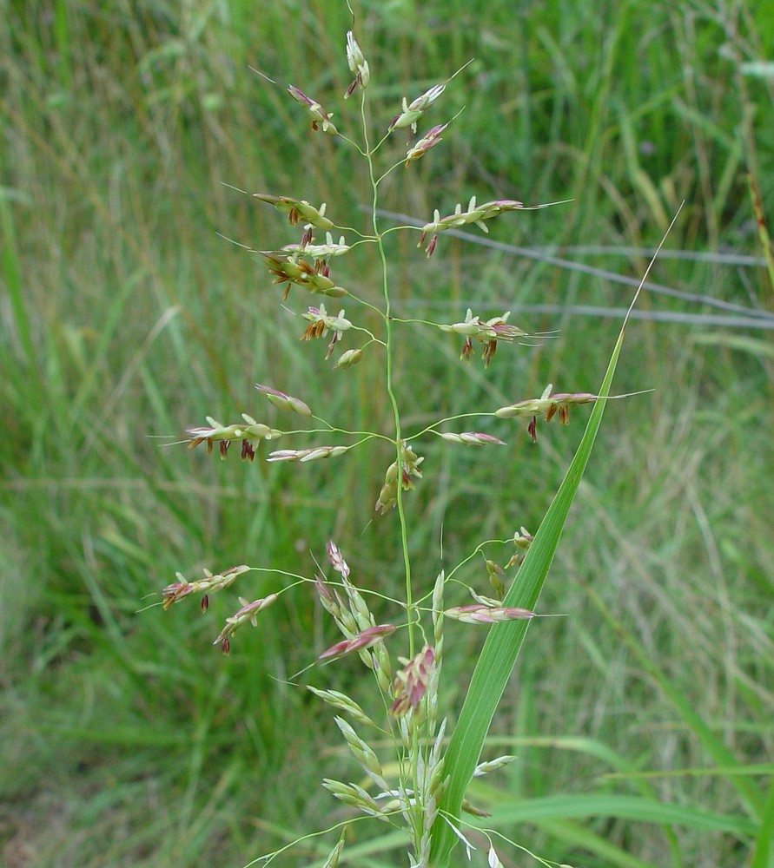
Sorghum Halepense a.k.a. Ban Chari

Slide 36
Rainy Sugarcane

Slide 37
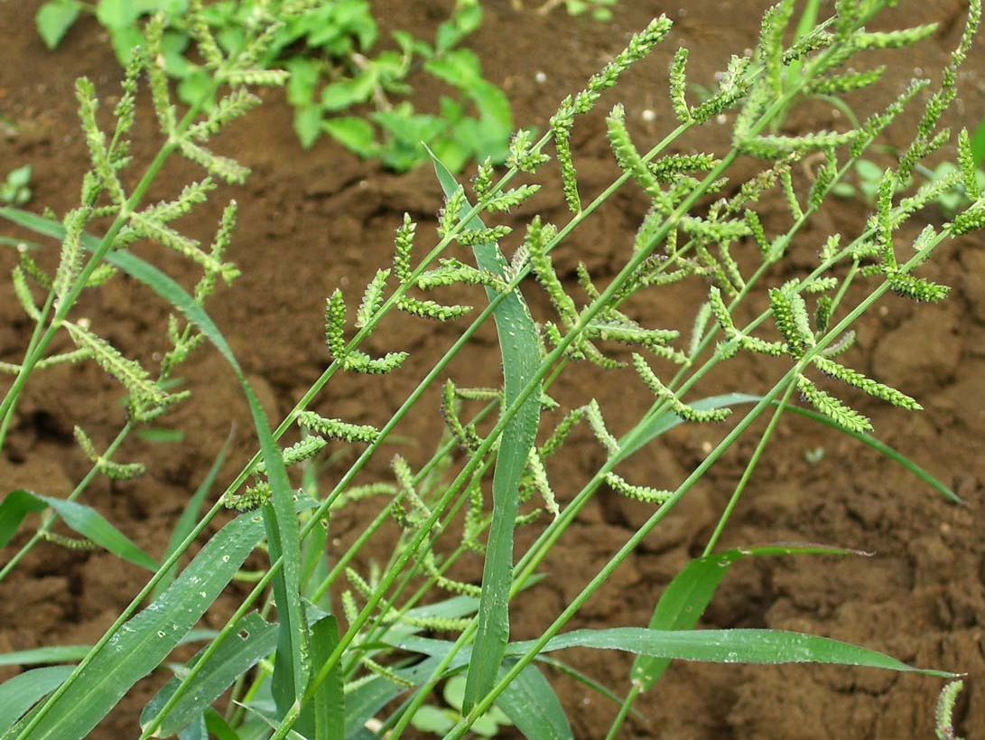
Echinochloa colonum a.k.a. Sama grass

Slide 38
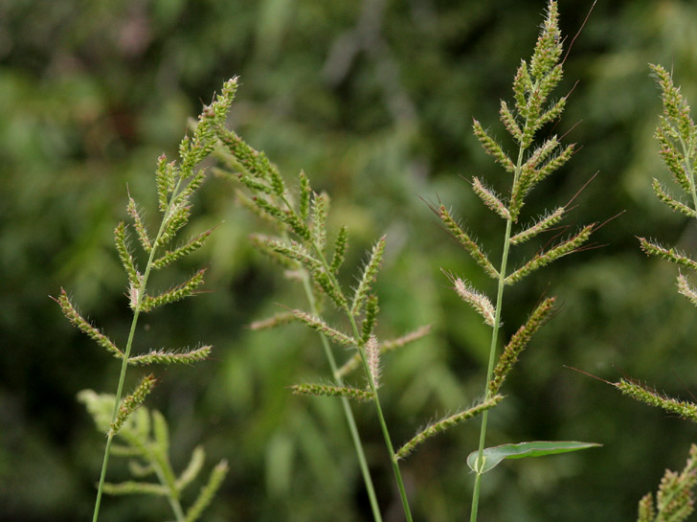
Echinochloa crusgalli a.k.a. Sama grass

Slide 39
Chemical Methods in Weed Control
2, 4-D specifically kills broadleaf weeds in Autumn Cane
Applied 25-30 days after planting or before the weeds attain 3-4 leaf stage
Rate of application : 1 kilograms/hectare in 500-600 liter of water

Slide 40
Atrazine is used for weed control in Spring Cane
Applied just after planting
Rate of application : 2 kilograms/hectare in 500-600 liter of water followed by 1 kilograms/hectare 2, 4-D, after 60 days of planting (MOST EFFECTIVE)

Slide 41
Harvesting
Early December in northern parts of India
But, the content of juice keeps on rising till March end
Maturity Recognition is confirmed by :
Withering of lower leaves
Fever green leaves on the top
Hand Sugar Refractometer : Test the sample from middle portion of stalk
Reading : 17-18 => Ready to Harvest

Slide 42
Yield
Average yield of 11-12 months old planted crop is 400 – 500 quintals/hectare of cane (Northern India)
Good crop : 800 – 1000 quintals/hectare
Average yield of 18 months old crop is 1000 – 1200 quintals/hectare (Southern India : TN and Maharashtra)

Slide 43
References
Singh, C. (2008). Modern Techniques of Raising Field Crops: pp 465 - 489 Oxford & IBH
Photographs retrieved from Wikimedia Commons on 4/7/17

Slide 44
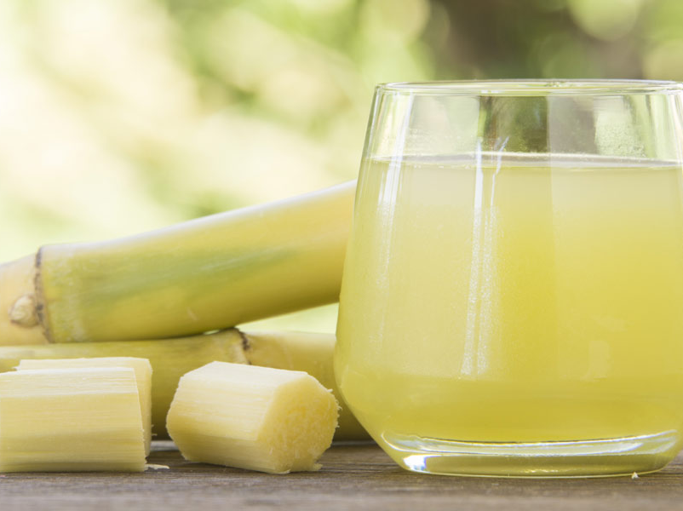
Thank You !

